Slide 1
Introduction to
International Business Administration

Slide 2
Global Human Resource Management
Notes:
This is a test

Slide 3
Prof. Dr. Amit Shah
Notes:
This is a test

Slide 4
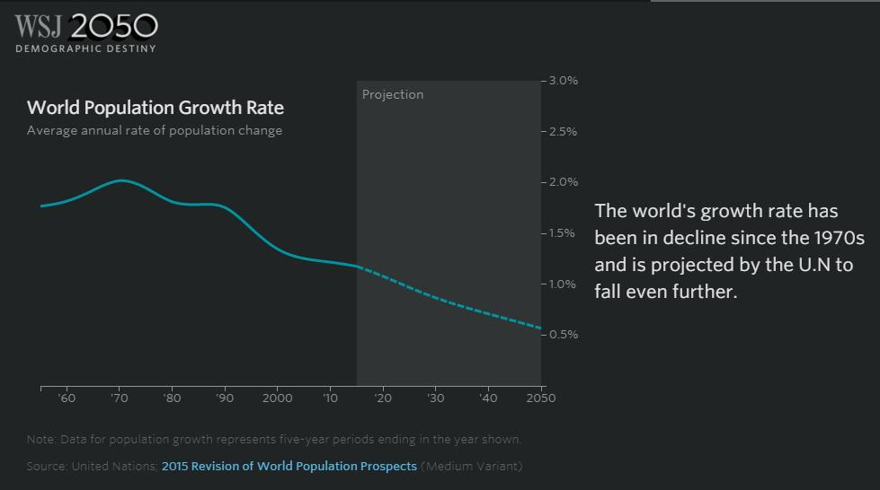
Will There Be Any People?

Slide 5

Who Will be Left?

Slide 6

Why?

Slide 7
World’s Population Projections
World’s population is projected to nearly stop growing by the end of the century.
The global fertility rate is expected to be 1.9 births per woman by 2100, down from 2.5 today.
The world’s median age is expected to increase to 42 in 2100, up from the current 31 – and from 24 in 1950.
Africa is the only world region projected to have strong population growth for the rest of this century.
Europe and Latin America are both expected to have declining populations by 2100.
In the Northern America region, migration from the rest of the world is expected to be the primary driver of continued population growth.

Slide 8
Human Resource Management (H R M)
  HRM -- Activities an organization carries out to utilize its human resources effectively.
    Determining human resource strategy.
    Staffing.
    Performance evaluation.
    Management development.
    Compensation.
    Labor relations.
Notes:
None of these global HRM activities is performed in a vacuum; all are related to the global strategy of the firm.

Slide 9
Human Resource Management
Different approaches to staffing policy
Foreign postings
  Why do managers fail?
  How can they increase their chances of success?
The role of training, management development, and compensation practices in IB

Slide 10
Human Resource Management
Activities aimed at effective use of human resources
  Staffing, management development, performance evaluation, compensation
Process complexity increases across borders
  Environmental differences of: labor markets, culture, legal systems, economic systems
  HR differences: compensation practices, labor laws, motivation issues
Notes:
Changes affect an organization coming from enviromental differences and hr differences

Slide 11
Staffing Policy
Staffing Policy
  Concerned with the selection of employees for a particular job.
  Selecting people with the right skills for a particular job.
  Developing and promoting the corporate culture of the firm: the organization’s norms and value systems.
    A strong corporate culture can help a firm implement its strategy.

Slide 12
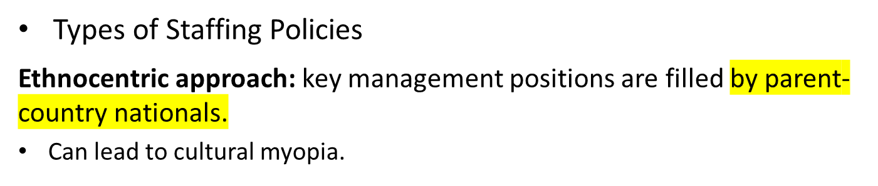
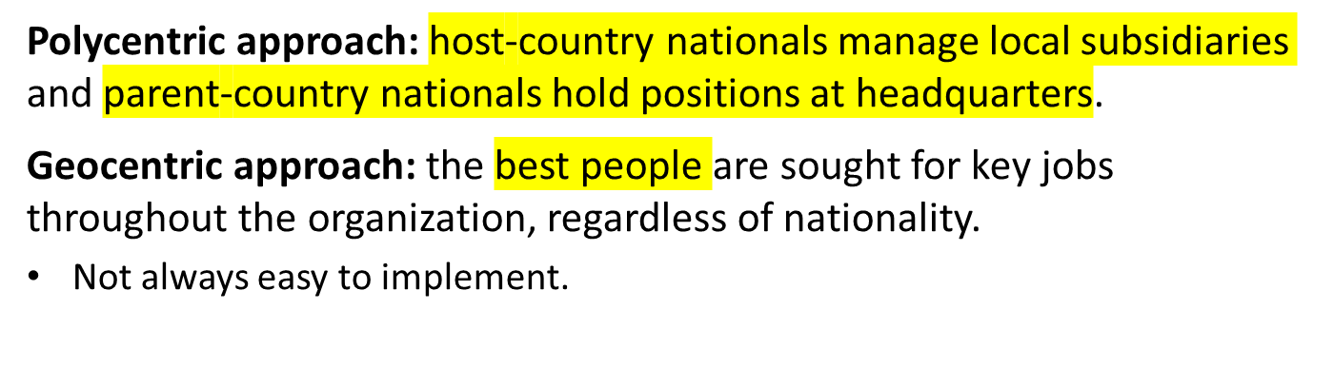
Staffing Policy
Notes:
An ethnocentric staffing policy is one in which all key management positions are filled by parent country nationals. This practice was widespread at one time. Firms pursue an ethnocentric staffing policy for three reasons.
First, the firm may believe the host country lacks qualified individuals to fill senior management positions.
Second, the firm may see an ethnocentric staffing policy as the best way to maintain a unified corporate culture.
Third, if the firm is trying to create value by transferring core competencies to a foreign operation, as firms pursuing an international strategy are, it may believe that the best way to do this is to transfer parent-country nationals who have knowledge of that competency to the foreign operation.

Slide 13
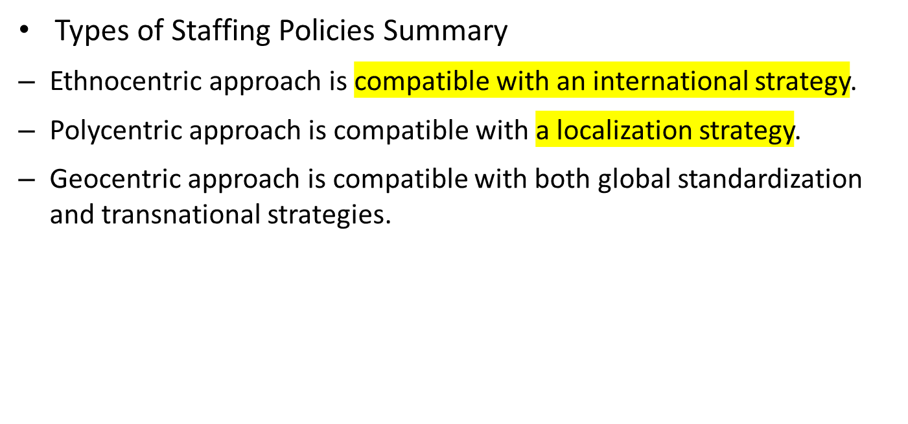
Staffing Policy
Notes:
Other critics note that the staffing policy adopted by a firm is primarily driven by its geographic scope, as opposed to its strategic orientation. Firms that have a broad geographic scope are the most likely to have a geocentric mindset.

Slide 14
Table: Comparison of Staffing Approaches
Staffing Approach | Strategic Appropriateness | Advantages | Disadvantages
Ethnocentric | International | Overcomes lack of qualified managers in host nation. Unifies culture. Helps transfer core competencies. | Produces resentment in host country. Can lead to cultural myopia.
Polycentric | Localization | Alleviates cultural myopia. Inexpensive to implement. | Limits career mobility. Isolates headquarters from foreign subsidiaries.
Geocentric | Global standardization and transnational | Uses human resources efficiently. Helps build strong culture and informal management networks. | National immigration policies may limit implementation. Expensive.
Notes:
The advantages and disadvantages of the three approaches to staffing policy are summarized in Table above.

Slide 15
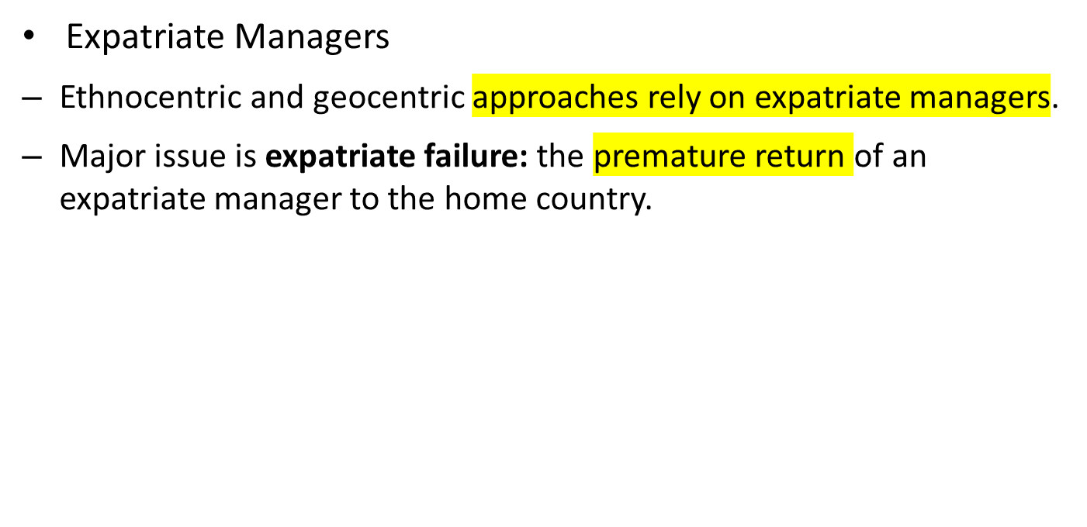
Staffing Policy
Notes:
As defined earlier, expatriates are citizens of one country who are working in another country. Sometimes the term inpatriates is used to identify a subset of expatriates who are citizens of a foreign country working in the home country of their multinational employer.

Slide 16
Expatriate Manager Failure Reasons
(in order of importance)
US MNCs
  “Trailing spouse” cannot adjust culturally
  Manager cannot adjust culturally
  Other family adjustment problems
  Manager’s lack of personal or emotional maturity
  Manager cannot cope with broader responsibility overseas
Japanese MNCs
  Manager cannot cope with broader responsibility overseas
  Manager cannot adjust culturally
  Manager’s lack of personal or emotional maturity
  Lack of technical competence
  Spouse cannot adjust culturally

Slide 17
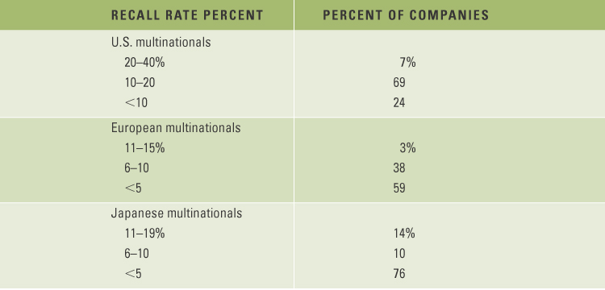
Expatriate Failure Rates

Slide 18
Staffing Policy
Expatriate Failure Rates
  Expatriate failure represents a failure of the firm’s selection policies to identify individuals who will not thrive abroad.
  U.S. firms have higher expatriate failure rates than either European or Japanese firms.
    One study shows that 76 percent of U.S. M N Es had expatriate failure rates of 10 percent or more and 7 percent had failure rates as high as 20 percent.
    Cost estimates of each expatriate failure: $40,000 to $1 million.
Notes:
A more recent study of 136 large multinationals from four different countries found that the rate of premature return of expatriate managers had dropped to 6.3 percent and that there was little difference between multinationals from different nations. The authors of this study suggest that multinationals have gotten much better at the selection and training of expatriates since Tung’s study.

Slide 19
Expatriate Success Predictors
Self-orientation
  Strengthen self-esteem, self-confidence, mental well-being
  Adapt to food, music, sport, outside interests
  Superior technical competency
Others-orientation
  Enhance ability to interact effectively with host nationals
  Relationship development, willingness to communicate
Perceptual ability
  Understand why people behave the way they do
  Non-judgmental, non-evaluative in interpreting others’ behavior
Cultural toughness
  How difficult to adjust to host culture?
From: Mendenhall and Oddou

Slide 20
Career Development for Expatriates
Pre-departure, on-site training
  Cultural training
  Language training
  Practical training
  Join a service club (Rotary, Lions, Kiwanis, Zonta, etc.)
Repatriation
  Many repatriating expatriates lost to MNCs because suitable positions not available at home
  Autonomy, span of control, compensation
  Repatriation strategy failure makes recruitment of competent expatriates difficult
  ‘Out of sight, out of mind.’

Slide 21
Performance appraisal Issues
Performance appraisal
  Two groups with conflicting perspectives/cultures appraise the expatriate: home managers, host managers
Compensation
  Different national standards
  Expatriate pay issues: base pay, cost-of-living, housing, education, hardship, foreign-service-premium, double-taxation, medical/pension benefits, home leave

Slide 22
Performance Appraisal
Two groups evaluate expatriate managers, both biased
  Host-nation managers
  Home-country managers
Home-country managers
  Distance bias
  No understanding of international business challenges
  Hard data often obscure soft issues
Host-nation managers
  “foreign spy” syndrome
  Expatriate’s career depends on home-country perception

Slide 23
Performance Appraisal
Guidelines for Performance Appraisal
  More weight should be given to onsite manager's appraisal than to offsite manager's appraisal.
  A former expatriate who has served in the same location should be involved in the appraisal process.
  Home-office managers should be consulted before onsite manager completes a formal termination evaluation.
Notes:
Due to proximity, an onsite manager is more likely to evaluate the soft variables that are important aspects of an expatriate’s performance.

Slide 24
Compensation
Expatriate Pay
  Most common approach to expatriate pay is the balance sheet approach.
    Equalizes purchasing power across countries so employees can have same standard of living in foreign country as at home.
  Typical compensation packages include:
    Base salary.
    Foreign service premium.
    Allowances.
    Benefits.
    Tax differentials.
Notes:
The most common approach to expatriate pay is the balance sheet approach. According to Organizational Resources Counselors, some 80 percent of the 781 companies it surveyed used this approach.

Slide 25
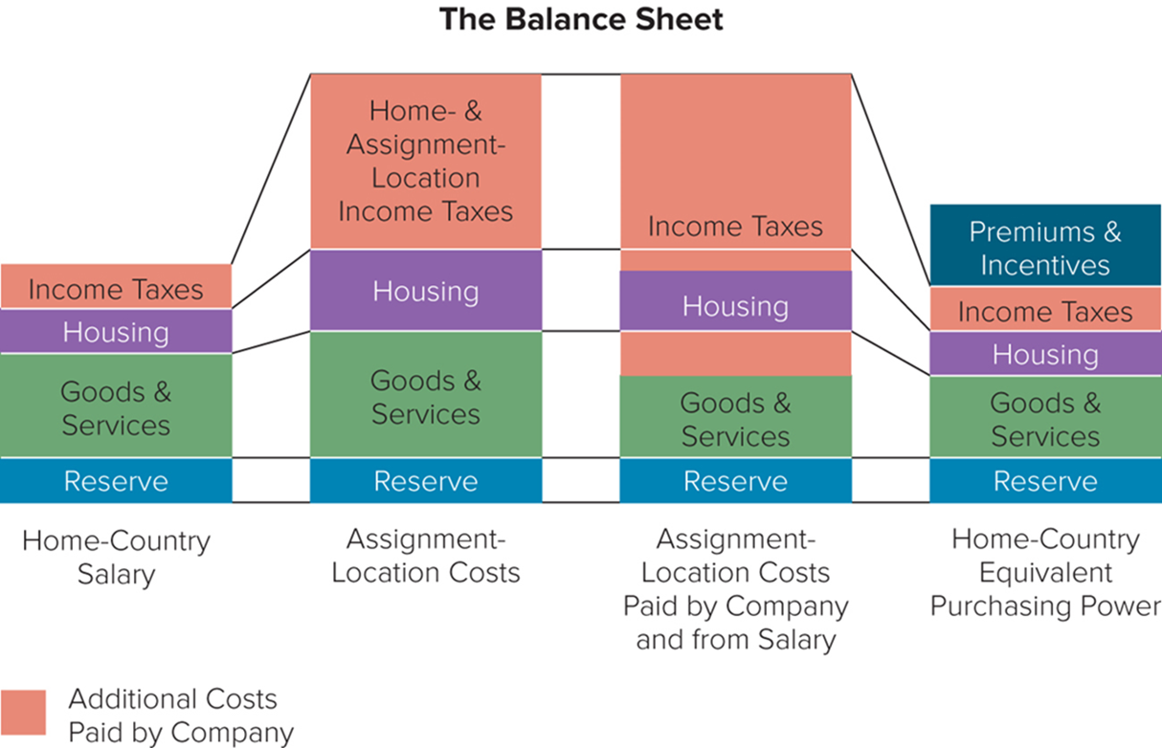
The Balance Sheet Approach to Expatriate Pay
Notes:
Figure above shows a typical balance sheet. Note that home-country outlays for the employee are designated as income taxes, housing expenses, expenditures for goods and services (food, clothing, entertainment, etc.), and reserves (savings, pension contributions, etc.).

Slide 26
Compensation
Expatriate Pay continued
  Base salary: normally in the same range as the base salary for a similar position in the home country.
  Foreign service premium: extra pay the expatriate receives for working outside the country of origin.
      Offered as an inducement to accept foreign postings.
  Allowances:
      Hardship allowance.
      Housing allowance.
      Cost-of-living allowance.
      Education allowance.
Notes:
Four types of allowances are often included in an expatriate’s compensation package: hardship, housing, cost of living, and education.
A hardship allowance is paid when the expatriate is being sent to a difficult location, usually defined as one where such basic amenities as health care, schools, and retail stores are grossly deficient by the standards of the expatriate’s home country.
A housing allowance is normally given to ensure that the expatriate can afford the same quality of housing in the foreign country as at home.
A cost-of-living allowance ensures that the expatriate will enjoy the same standard of living in the foreign posting as at home.
An education allowance ensures that an expatriate’s children receive adequate schooling (by home-country standards).

Slide 27
Building a Diverse Global Workforce
Diverse Global Workforce
  Source of competitive advantage and higher profits.
  Diversity improves performance:
    Diverse talents bring insights into needs of diverse customer base.
    Capitalizes on the talent of women and minorities.
    Develops a better relationships with diverse customer base.
    May improve brand image.
    Increases employee satisfaction.
Notes:
A diverse workforce is one that has a significant mix of all genders and in which cultural and ethnic minorities are well represented.
The available evidence suggests that many companies still have a long way to go when it comes to promoting diversity.

Slide 28
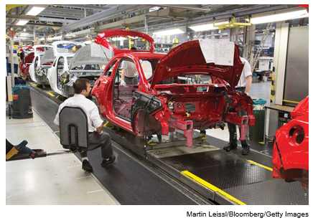
International Labor Relations
The Concerns of Organized Labor
  Multinationals can counter union bargaining power by threatening to move production to another country.
  Multinationals will keep highly skilled tasks in the home country and farm out only low-skilled tasks.
  Imported employment practices and contractual agreements will reduce union influence and power.
Employees work on the chassis of an Adam Opel A G car at a G M factory in Eisenach, Germany.
Notes:
The HRM function of an international business is typically responsible for international labor relations. From a strategic perspective, the key issue in international labor relations is the degree to which organized labor can limit the choices of an international business.

Slide 29
International Labor Relations
The Strategy of Organized Labor
  Trying to establish their own international organizations.
  Lobbying for national legislation to restrict multinationals.
  Trying to achieve regulations of multinationals through international organizations such as the United Nations.
  In 19 60s, organized labor began to establish international trade secretariats (I T Ts).
  So far, these efforts have had only limited success.
Notes:
Although national unions may want to cooperate, they also compete with each other to attract investment from international businesses and hence jobs for their members. A further impediment to cooperation has been the wide variation in union structure. Organized labor has also met with only limited success in its efforts to get national and international bodies to regulate multinationals.

Slide 30
International Labor Relations
Approaches to Labor Relations
  Traditionally, most labor relations have been decentralized to individual subsidiaries.
  Trend now is toward greater centralized control.
  Some firms threaten unions with moving production in order to limit wage increases.
Notes:
International businesses differ markedly in their approaches to international labor relations. The main difference is the degree to which labor relations activities are centralized or decentralized.

Slide 31
End of HR Lecture

